Slide 1
Case study presentation
Alessio Ciullo
alessio.ciullo@deltares.nl

Slide 2


Aim of the project:
Develop a flood risk management plan for the upper branch of the IJssel River applying the notions on decision-making under (deep) uncertainty acquired throughout the course.
What is a flood?
From Wikipedia: A flood is an overflow of water that submerges land that is usually dry.
What is flood risk management (FRM)?
From Hall et al. (2003): FRM is the process of data and information gathering, risk assessment, appraisal of options, and making, implementing and reviewing decisions to reduce, control, accept or redistribute risks of flooding”.
this is not a mere modelling project, though modelling takes a big share of it! Each project must appropriately comment on the policy implications of the adopted strategies.

Slide 3
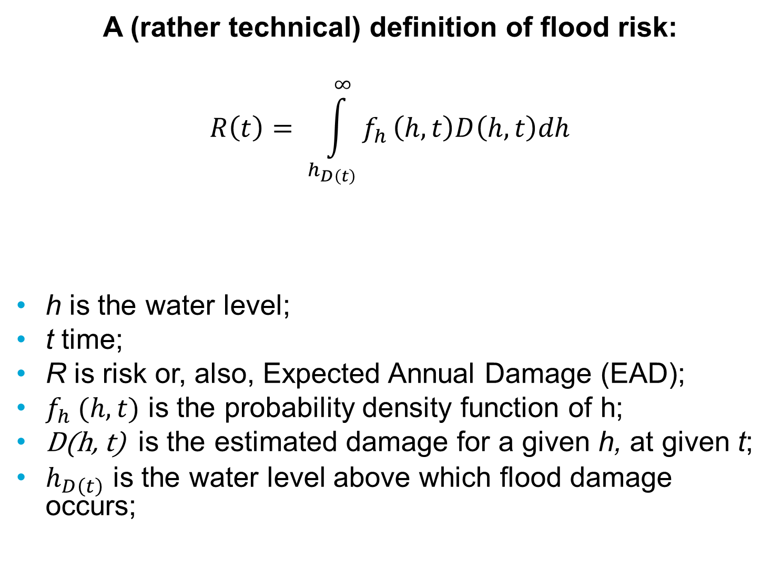
A (rather technical) definition of flood risk:
$$R\left(t\right)= \int_{h_{D\left(t\right)}}^{∞}{f_{h}}\left(h,t\right)D\left(h,t\right)dh$$
h is the water level;
t time;
R is risk or, also, Expected Annual Damage (EAD);
$f_{h} (h,t)$ is the probability density function of h;
D(h, t) is the estimated damage for a given h, at given t;
$h_{D\left(t\right)}$ is the water level above which flood damage occurs;
According to the scope of the measure in decreasing either f or D, we distinguish:
Flood protection
measures
Flood mitigation
measures

Slide 4
Flood protection measures
Build/raise dikes, dunes and dams. It prevents the occurrence of flood events by increasing the resistance of the embankment system;
Increase the capacity of the river bad (so-called room for the river). It prevents the occurrence of flood events by allowing higher discharges (volume of water per unit time) to be safely conveyed into the river;

Slide 5
Flood mitigation measures
Early warning systems. It allows a timely communication of the threat;
Elevated buildings. It allows buildings to withstand higher water levels before experiencing damage;
Awareness raising actions. It fosters appropriate and responsible behavior amongst the affected people in case of floods, which then take precautionary measures (e.g. by moving valuable items to elevated areas);

Slide 6
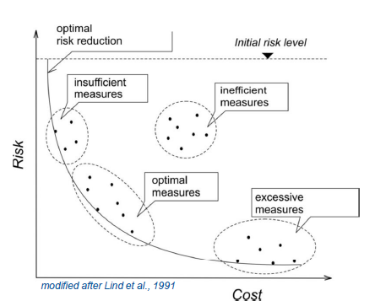
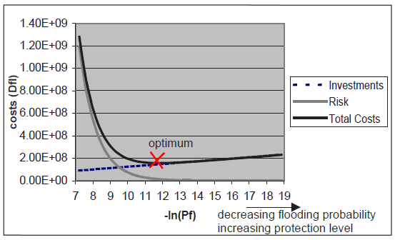
How to choose measures:
Search for the optimal (design) protection level:
Explore the pool of available measures, trading-off risk and costs:

Slide 7
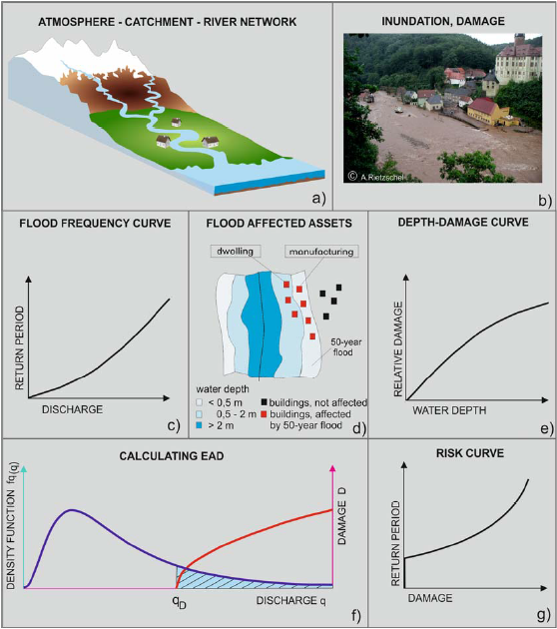
Flood risk assessment: the modelling chain
For a description of the chain and much more, see here

Slide 8
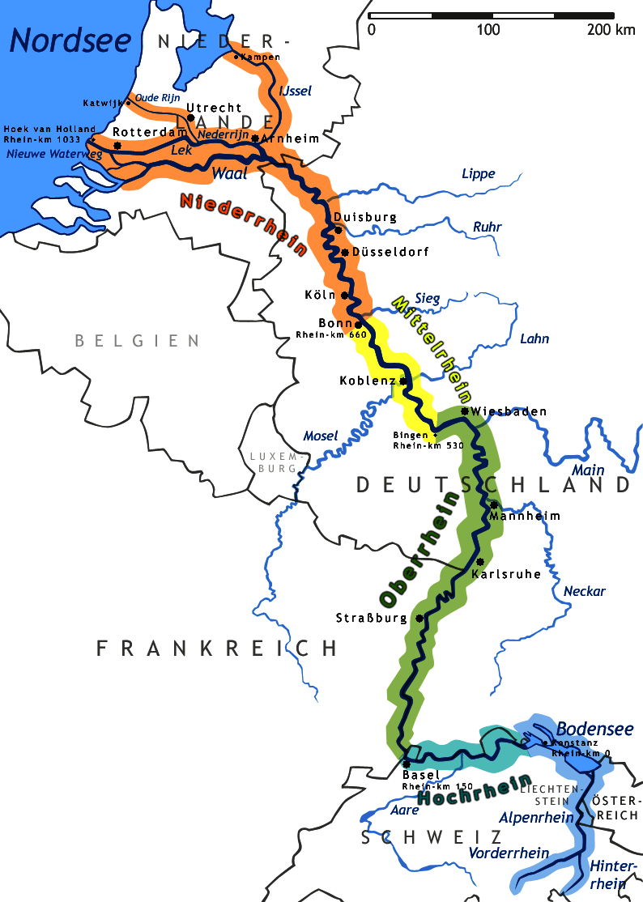
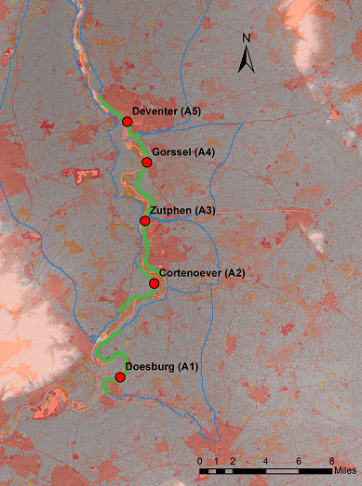
Case study: the IJssel River

Slide 9
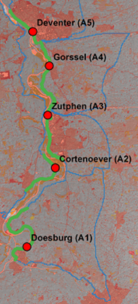
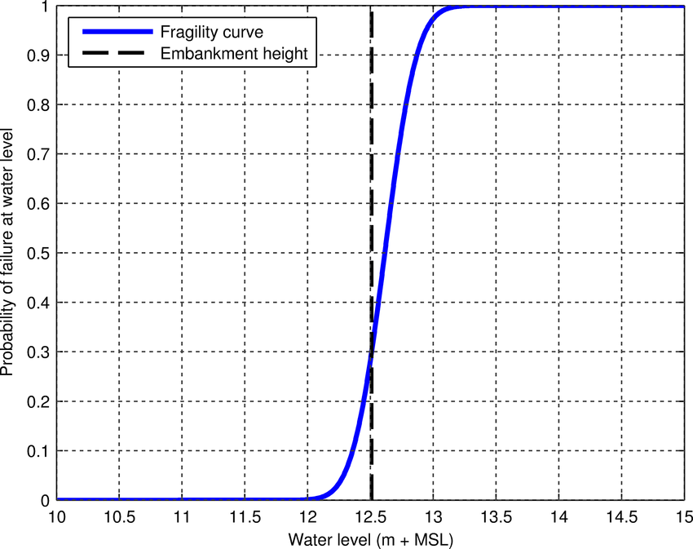
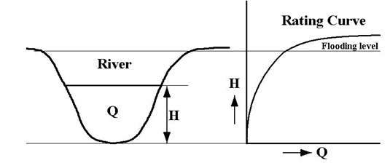


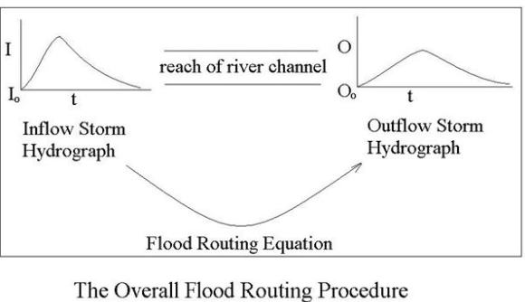
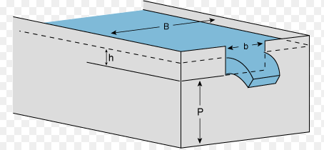
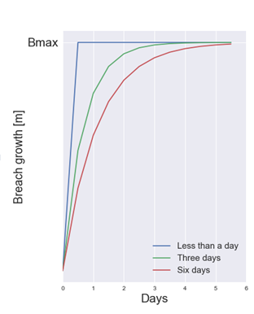



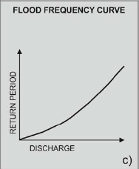
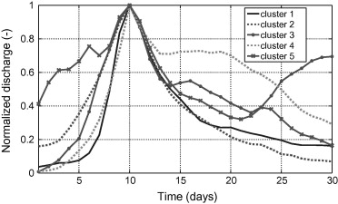
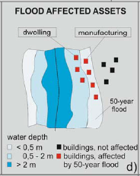
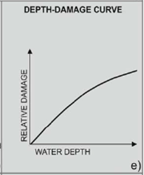
Flood risk assessment: our modelling chain
3
a. Translate discharges into water levels
b. Evaluate failure
For all locations & more events
If any of the wl from step 1 > critical water level → failure
2
c. Assess flooding discharge through a weir formula
1
Probability of the event | Water level | Damage
……. | ……. | …….
…….. | …….. | ……..
……. | ……. | …….
*

Slide 10
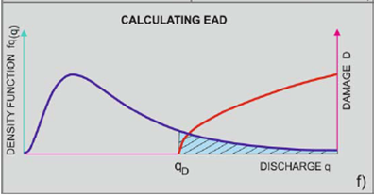

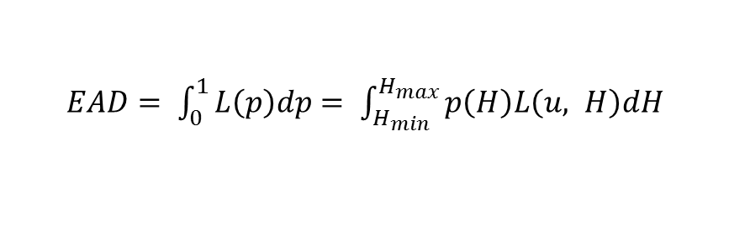
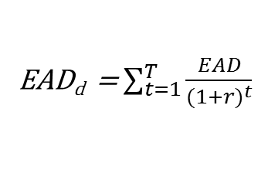
From damage to risk:
At each location, we now have a set of damages each associated to a different upstream high discharge, whose probability is known. Clearly, the lower the probability, the higher the discharge, the higher the damage.
$EAD= \int_{0}^{1}{L\left(p\right)dp= \int_{H_{min}}^{H_{max}}{p\left(H\right)L\left(u, H\right)dH}}$
EAD_{d} = $\sum_{t=1}^{T}{\frac{EAD}{{(1+r)}^{t}}}$
T = planning period
r = discount rate

Slide 11


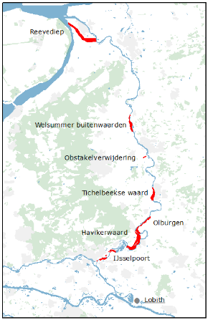
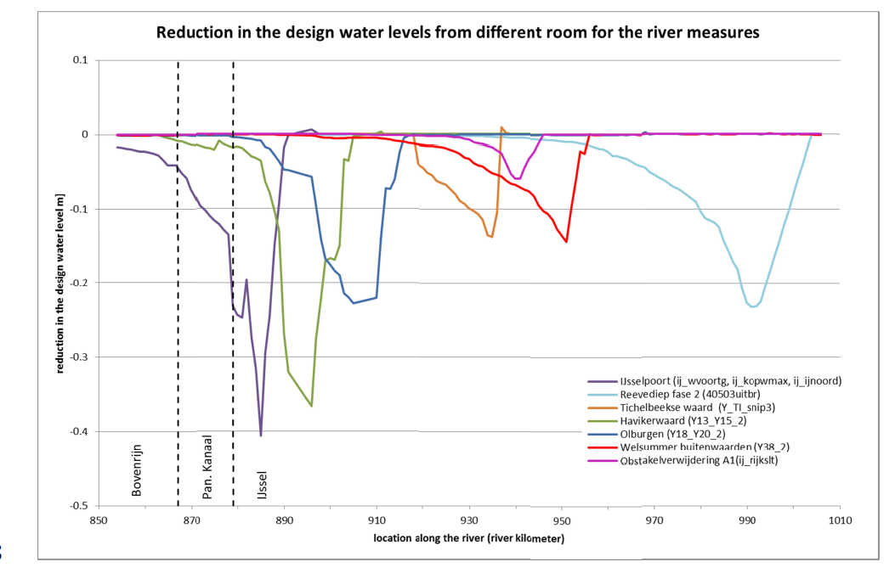
Available measures:
Dike heightening: (per location)
Early warning:
Cost = # of people evacuated*22 [euros/person/day] *(warning time [days] + 3) (based on the 1995 event)
Room for the River:
cost function from Eijgenraam (2017)
pics and data from kind et al. (2018)

Slide 12
Outcomes & problem formulations
17 Outcomes of interest:
Expected Annual at each location
Expected Casualties at each location
Dike Investment costs at each location
Evacuation costs
Room for the river costs
You should make your own PF, and it should be properly justified. If using direct search, do not use too many objectives (do not exceed 13).

Slide 13
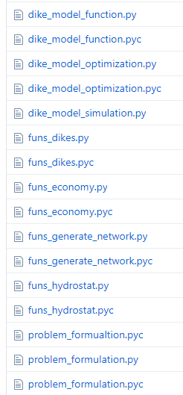
How does the model look like:
Input functions in order to model:
Dike failure occurrence and dynamic;
Dike raising costs and discounting of EAD;
Generate the network of locations containing all sort of info;
The statistic of high discharges upstream;
Actual model simulating the whole chain;
Function preparing levers, uncertainties and outcomes to input to the EMA-workbench by choosing one of the four problem formulations;
Call the problem formulation and run with the EMA-workbench :
search;
exploration;

Slide 14
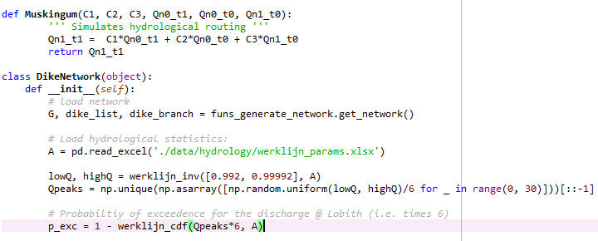
dike_model_function.py
1- Hydrological routing function
2- Properties of the adopted GEV distribution for upstream high discharges. You may want to play with its parameters to simulate climate change.
3- Set the probability boundaries within which events are sampled. Usually in flood risk management we are interested in the upper tail.
4- Uniformly sample events within the selected boundaries, and order them in descending order. In this way we assure to have decreasing EADs. The GEV relates to high discharges of the Rhine @Lobith, and approx. (this is uncertain) 1/6 of it reaches the IJssel.
5- Find the probability of exceedance of each event, paramount to estimate risk (note: Its inverse is called Return Period). To give an idea, this stretch is designed to withstand events whose RP is 1250 years, which means a non-exceedence probability (like the one you set at point3) of 0.9992.

Slide 15
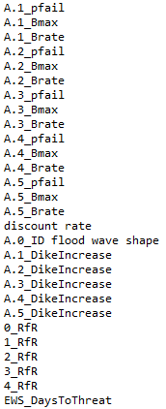
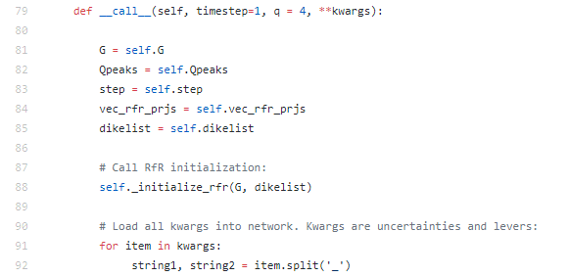
dike_model_function.py
uncertainties
Real
Category
Integer
levers
Boolean

Slide 16
GOOD LUCK!

Slide 17
References
Hall, J.W., Meadowcroft, I.C., Sayers, P.B. et al. (2003b). Integrated flood risk management in England and Wales, Nat. Hazards Rev., 4, 126–135.
Eijgenraam, C., Brekelmans, R., Hertog, D. Den and Roos, K. (2017) ‘Optimal Strategies for Flood Prevention’, Management Science, 63(5), pp. 1644–1656. doi: 10.1287/mnsc.2015.2395.
Vorogushyn, S., Merz, B., Lindenschmidt, K. E. and Apel, H. (2010) ‘A new methodology for flood hazard assessment considering dike breaches’, Water Resources Research, 46(8), pp. 1–17. doi: 10.1029/2009WR008475.
R.B. Jongejan, S.N. Jonkman, J.K. Vrijling, The safety chain: A delusive concept, Safety Science, Volume 50, Issue 5, 2012, Pages 1299-1303,
ISSN 0925-7535, https://doi.org/10.1016/j.ssci.2011.12.007.
(http://www.sciencedirect.com/science/article/pii/S0925753511003201)

